Slide 1
API Styles

Slide 2
The History of Distributed APIs:
Dawn of distributed computing
1981 RPC
~1970~ RPC concept Messaging Queuing
Notes:
Zacznijmy w 1970 I okolicach bo wtedy powstalo wiele konceptow api
RPC – pierwsza implementacja 81, ale concept pojawil sie w latach 70
RPC concept – jeden component rozmawia z drugim componentem tak jakby po drodze nie bylo polaczenia internetowego. Udaja ze nie ma (wszytko co potrzebne do komunikacji jest zaszyte pod spodem protokolu)

Slide 3
The History of Distributed APIs:
Object oriented APIs
1993 RDA
1998 XML-RPC
1981 RPC
1991 CORBA
~1970~ RPC concept Messaging Queuing
Notes:
RDA – remote data access – client quering interface
XML-RPC – formalna specyfikacja oparta o XML od Microsoftu
Common Object Request Broker Architecture (CORBA) is a standard defined by the Object Management Group (OMG) designed to facilitate the communication of systems that are deployed on diverse platforms. CORBA enables collaboration between systems on different operating systems, programming languages, and computing hardware. CORBA uses an object-oriented model although the systems that use the CORBA do not have to be object-oriented. CORBA is an example of the distributed object paradigm.

Slide 4
The History of Distributed APIs:
Balancing between SOAP and REST
1993 RDA
1998 XML-RPC
1999 SOAP
2000 REST
1981 RPC
1991 CORBA
~1970~ RPC concept Messaging Queuing
Notes:
RPC – pierwsza implementacja 81, ale concept pojawil sie w latach 70
SOAP – implementacja SOA (nadal oparta o zasady rpc -> bardzo silne wymuszanie kontraktow.
SOAP mial byc uniwersalny, ale nikt nie chcial go zaimplementowac u siebie I komunikacja miedzy roznymi serwisami nie byla prosta.
potrzebna byla reczna implementacja koperty komunikacyjnej XML ktora byla ogromna I skomplikowana
REST – Roy Filding w 2000 roku napisal prace o tym jak budowac API ktore zyly by w harmoni z tym jak dziala web I HTTP
REST I SOAP przez pare lat rownolegle sie sprawdzaly
Ale powoli Soap tracil na popularnosci na rzecz RESTa . Wlasciwie gdy Fb I Twitter wypuscily swoje API jako REST. To bylo duzym punktem zwrotnym dla RESTA
-> to byl czas gdy api powstawalo dla jednego klienta.

Slide 5
The History of Distributed APIs:
JSON is taking over XML
1993 RDA
1998 XML-RPC
1999 SOAP
2000 REST
2005 JSON-RPC
2007 Odata
1981 RPC
1991 CORBA
~1970~ RPC concept Messaging Queuing
Notes:
W 2005 JSON bierze gore nad XMLem
A w 2007 Microsoft powraca do koncepcji RDA I wypuszcza oData ktore jest jezykiem zapytan od strony klienta tlumaczonym bezposrednio na zapytania do bazy danych wykorzystujac po drodze EF
oData oddaje wladze na strone klienta. Mozemy tworzyc zapytania od strony klienta o dane ktorych potrzebujemy, nie musimy sie trzymac zalozen RESTa

Slide 6
The History of Distributed APIs:
Old ideas, new mutations
1993 RDA
1998 XML-RPC
1999 SOAP
2000 REST
2005 JSON-RPC
2007 Odata
2015 GraphQL
2016 gRPC
1981 RPC
1991 CORBA
~1970~ RPC concept Messaging Queuing
2011 WebSocket
Notes:
GraphQL – ponownie oddanie wladzy na strone klienta
gRPC – ponownie nowa implementacja. Koncentruje sie na wydajnosci I generowaniu kodu. Ma byc uzyteczna dla wszystkich
Granica 2010 -> to web 2.0 I szeroko dostepne, generyczne API przeznaczone dla wielu klientow, konsumerow (zjadaczy api) I partnerow
. Wazna elastycznosc
Kolejna fala to bedzie wiecej API rozmawiajacych ze soba (stad powrot grpc) I automatycznych API

Slide 7
The History of Distributed APIs:
1993 RDA
1998 XML-RPC
1999 SOAP
2000 REST
2005 JSON-RPC
2007 Odata
2015 GraphQL
2016 gRPC
1981 RPC
1991 CORBA
~1970~ RPC concept Messaging Queuing
2011 WebSocket
Notes:
Mamy wiec :
Niebieski -> RPC concept – jeden component rozmawia z drugim componentem tak jakby po drodze nie bylo polaczenia internetowego. Udaja ze nie ma (wszytko co potrzebne do komunikacji jest zaszyte pod spodem protokolu)
Czerwony -> query APIs, skoncentrowane na danych I oddajace wladze klientom
Zielony -> Web APIs – wykorzystujace bardzo mocno protocol sieciowy
a przy okazji sa one obiektowe – resourcowe, opieraja sie na transporcie obiektow z pelnym wykorzystaniem protokolu sieciowego.
Do tego mamy jeszcze
Flat File System – przesylanie plikow, nadal wykorzystywane.
Fiolet Streaming – tutaj gRPC implementuje obecnie, a wczesniej wiem ze byla taka opcja w soap. I wszystko co oparte o WebSockety – czyli np SignalR

Slide 9
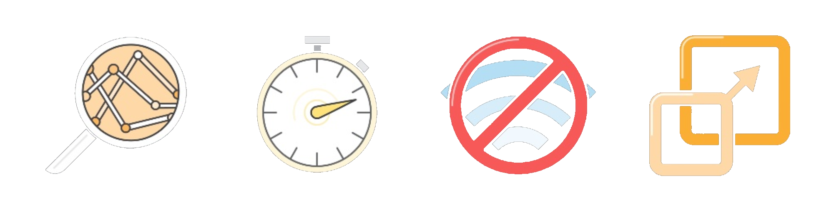
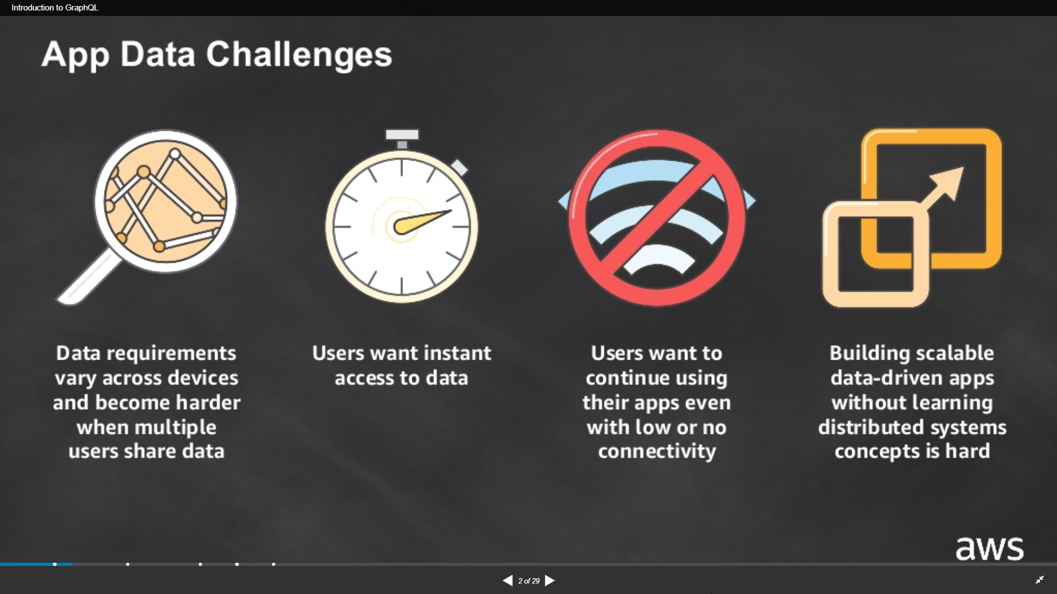

Slide 10
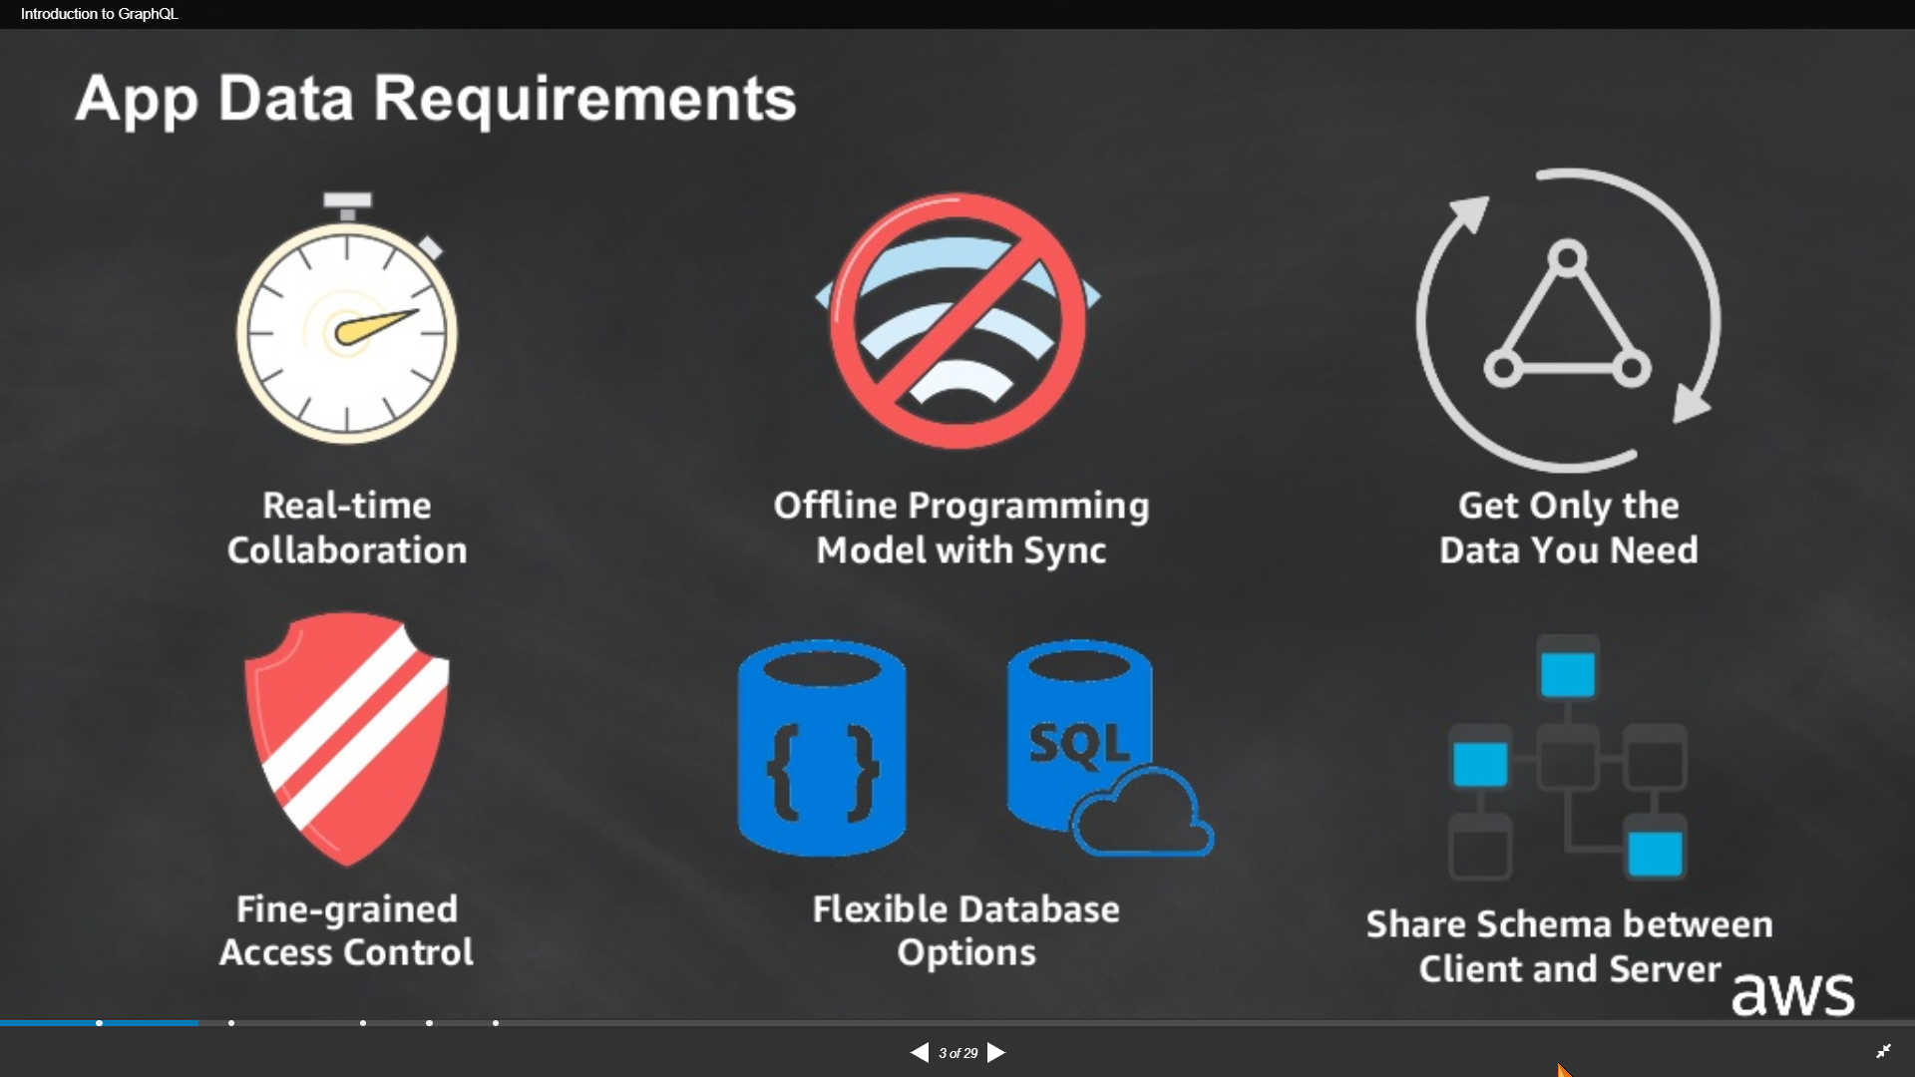

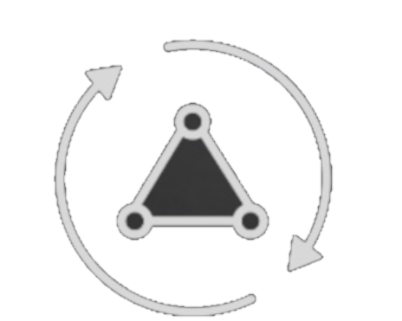

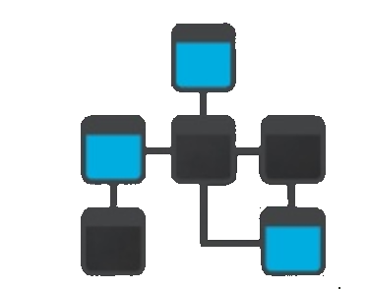
Notes:
https://www.slideshare.net/AmazonWebServices/introduction-to-graphql-95577414

Slide 11
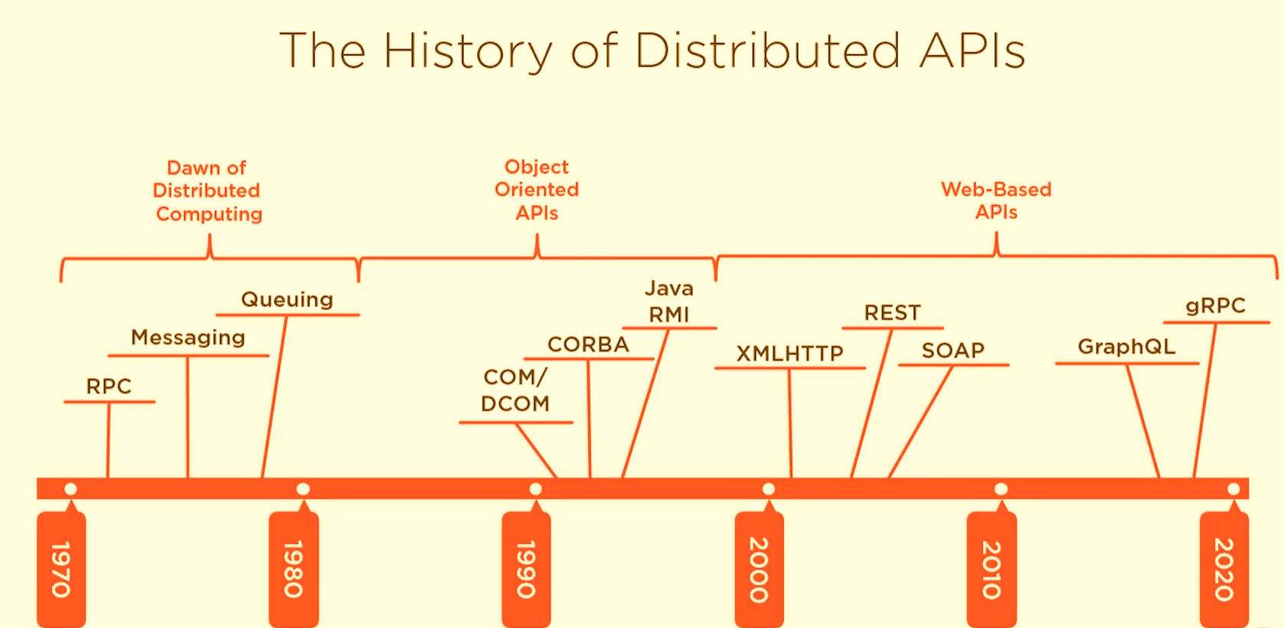
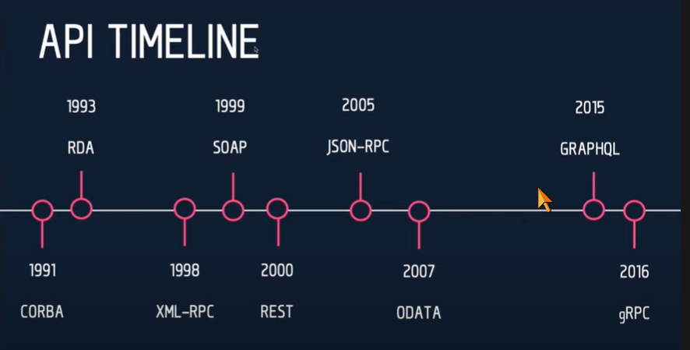
The History of Distributed APIs
Notes:
API community is small

Slide 12
REST API
Notes:
So what is .NET?

Slide 13
REST(ful)
REST
architecture type that’s using the existing web infrastructure
RESTful
services that implement REST architecture
Strict and pragmatic approach

Slide 14
REST
Stateless
Cacheable
Uniform interface
Identification of resources
Manipulation of resources through representations
Self-descriptive messages
Hypermedia and the engine of application state (HATEOAS)
Layered system
Client-server separation
https://restfulapi.net/
Notes:
Client–server – By separating the user interface concerns from the data storage concerns, we improve the portability of the user interface across multiple platforms and improve scalability by simplifying the server components.
Stateless – Each request from client to server must contain all of the information necessary to understand the request, and cannot take advantage of any stored context on the server. Session state is therefore kept entirely on the client.
Cacheable – Cache constraints require that the data within a response to a request be implicitly or explicitly labeled as cacheable or non-cacheable. If a response is cacheable, then a client cache is given the right to reuse that response data for later, equivalent requests.
Uniform interface – By applying the software engineering principle of generality to the component interface, the overall system architecture is simplified and the visibility of interactions is improved. In order to obtain a uniform interface, multiple architectural constraints are needed to guide the behavior of components. REST is defined by four interface constraints: identification of resources; manipulation of resources through representations; self-descriptive messages; and, hypermedia as the engine of application state.
Layered system – The layered system style allows an architecture to be composed of hierarchical layers by constraining component behavior such that each component cannot “see” beyond the immediate layer with which they are interacting.
Code on demand (optional) – REST allows client functionality to be extended by downloading and executing code in the form of applets or scripts. This simplifies clients by reducing the number of features required to be pre-implemented.

Slide 15
REST(ful)
REST
architecture type that’s using the existing web infrastructure
RESTful
services that implement REST architecture
Web resources – identified with URL address
Resource A – create not CreateResource(A)
HTTP verbs
GET, POST, PUT, DELETE, PATCH…
JSON or XML
Notes:
Tak naprawde wszystkie wojny o rest sa bez sensu :D
Wykorzystuje sie HTTP ale to z wygody porownania. Ale nie dlatego ze tak ma byc

Slide 16
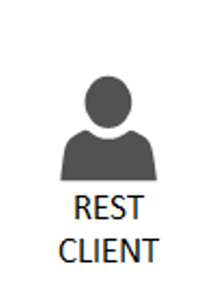

HTTP REST CRUD
C
R
U D
Http POST routing + payload
201 + location
Http GET routing
200 + payload list
Http GET routing/{id}
200 + payload
Http PUT routing/{id}
200
Http DELETE routing/{id}
200

Slide 17
HTTP Codes
1xx: Information
2xx: Success
3xx: Redirection
4xx: Client Error – You did screw up
5xx: Server Error – I did screw up

Slide 18
gRPC

Slide 19
What is gRPC?
Binary communication
Contract-based
Available across ecosystems
Secure by default (requires HTTP/2, TLS, SSL)
Uni and Bi directional streaming
Notes:
One way or two way streaming

Slide 20
gRPC for the Web
HTTP/2 – most browsers don’t suport it yet
Binary format – harder for JS to parse
Required contracts – that’s not so great for Web apps

Slide 21
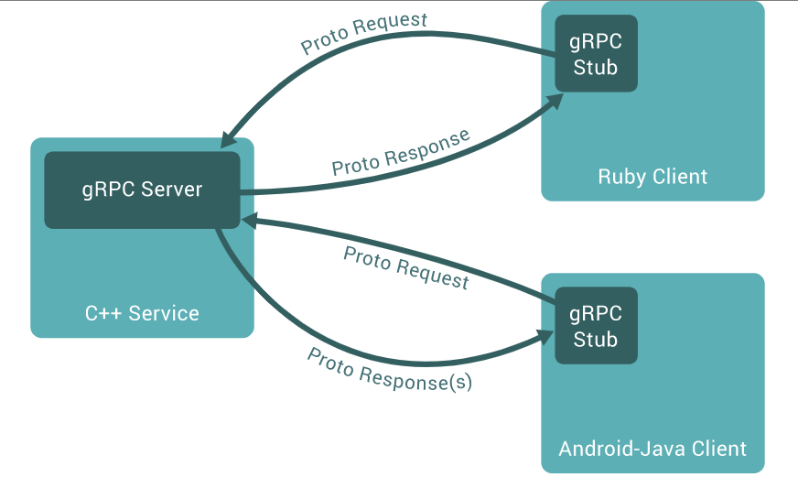
gRPC so where?
IoT
Containers
Service to service communication

Slide 22
Contracts
Generated clients/servers
Uses interface definitione language Protocol Buffers (ProtoBuf)
Language independent
message Person
{
string name = 1;
int32 id = 2;
bool has_ponycopter = 3;
}
https://docs.microsoft.com/en-us/aspnet/core/tutorials/grpc/grpc-start?view=aspnetcore-3.1&tabs=visual-studio

Slide 23
// The greeter service definition.
service Greeter {
// Sends a greeting
rpc SayHello (HelloRequest) returns (HelloReply) {}
}
// The request message containing the user's name.
message HelloRequest {
string name = 1;
}
// The response message containing the greetings
message HelloReply {
string message = 1;
}

Slide 24
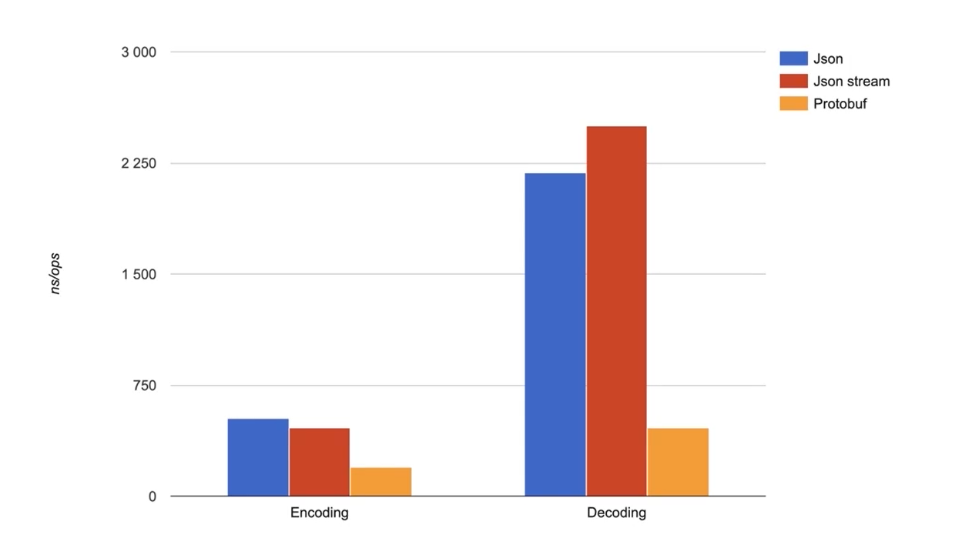
ProtoBuf is fast

Slide 25
Example .NET
syntax = "proto3";
option csharp_namespace = "GrpcExampleService";
package johoot;
// The greeting service definition.
service QuizeDefinition {
rpc SayHello (HelloRequest) returns (HelloReply);
rpc GetQuizeByID (QuizeIdMessage) returns (QuizeMessage);
rpc CreateQuize (QuizeMessage) returns (QuizeIdMessage);
}
// The request message containing the user's name.
message HelloRequest {
string name = 1;
}
message QuizeIdMessage{
int64 id = 1;
}
message QuizeMessage{
int64 id =1;
string name=2;
string description =3;
repeated QuestionMessage QuestionList =4;
}
message QuestionMessage{
int64 id = 1;
string text =2;
map<bool, string> answers = 3;
}
// The response message containing the greetings.
message HelloReply {
string message = 1;
}
syntax = "proto3";
option csharp_namespace = "GrpcExampleService";
package johoot;
// The greeting service definition.
service QuizeDefinition {
rpc SayHello (HelloRequest) returns (HelloReply);
rpc GetQuizeByID (QuizeIdMessage) returns (QuizeMessage);
rpc CreateQuize (QuizeMessage) returns (QuizeIdMessage);
}
// The request message containing the user's name.
message HelloRequest {
string name = 1;
}
message QuizeIdMessage{
int64 id = 1;
}
message QuizeMessage {
int64 id =1;
string name=2;
string description =3;
}
// The response message containing the greetings.
message HelloReply {
string message = 1;
}
Spacing matters
Many methods in one service
Simple types

Slide 26
ASP.NET Core configuration
public void ConfigureServices(IServiceCollection services)
{
services.AddGrpc();
}
public void Configure(IApplicationBuilder app, IWebHostEnvironment env)
{
if (env.IsDevelopment())
{
app.UseDeveloperExceptionPage();
}
app.UseRouting();
app.UseEndpoints(endpoints =>
{
endpoints.MapGrpcService<QuizeDefinitionService>();
endpoints.MapGet("/", async context =>
{
await context.Response.WriteAsync("Communication with gRPC endpoints
must be made through a gRPC client. To learn how to create a client,
visit: https://go.microsoft.com/fwlink/?linkid=2086909");
});
});
}

Slide 27
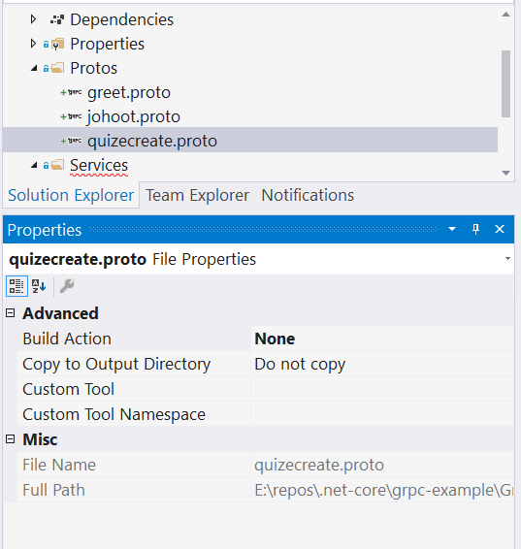
Add proto
Adding new file is not telling DotNet that it’s gRPC
https://docs.microsoft.com/en-us/aspnet/core/tutorials/grpc/grpc-start?view=aspnetcore-3.1&tabs=visual-studio

Slide 28
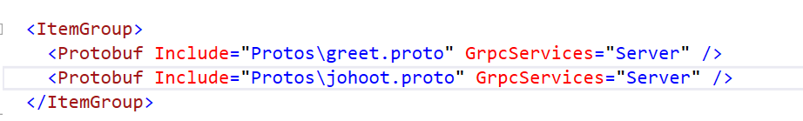
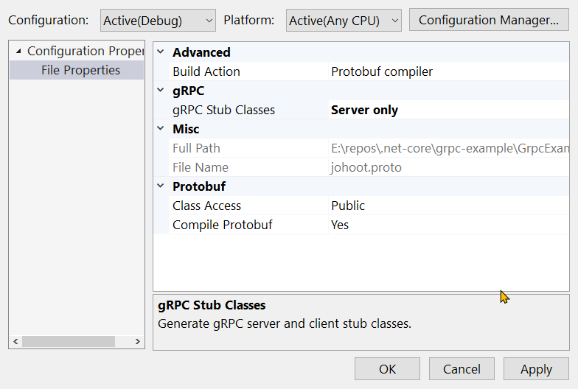
Introduce gRPC to generate classes

Slide 29
Other types
message QuizeMessage{
int64 id =1;
string name=2;
string description =3;
repeated QuestionMessage QuestionList =4;
}
message QuestionMessage{
int64 id = 1;
string text =2;
map<bool, string> answers = 3;
}
var result = new QuizeMessage
{
Id = 19,
Name = "Bla bla quize",
Description = "some more bla bla ",
QuestionList =
{
new QuestionMessage {
Id=21,
Text="question1"},
new QuestionMessage {
Id=23,
Text="question3",
Answers={
{true,"this is good" },
{ false, "this is not so good"}
}
},
}
};

Slide 30
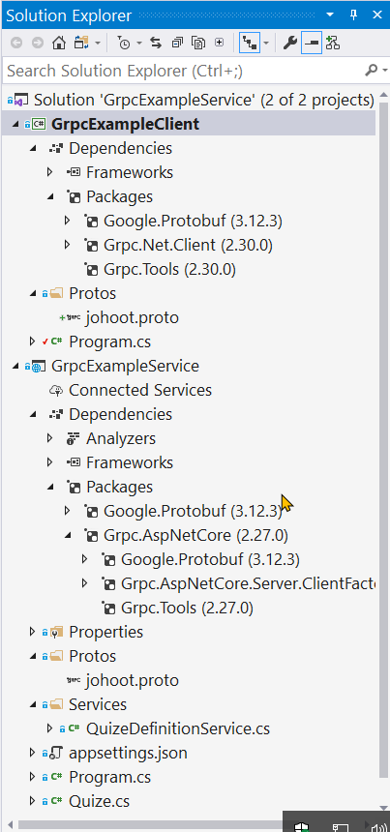
gRPC Client
Any app – here ConsollApp
Include *.proto files
Nugget
Install-Package Grpc.Net.Client
Install-Package Google.Protobuf
Install-Package Grpc.Tools

Slide 31
gRPC Client call service
class Program
{
static void Main(string[] args)
{
Console.WriteLine("Hello World!");
// The port number(5001) must match the port of the gRPC server.
var channel = GrpcChannel.ForAddress("https://localhost:5001");
var client = new QuizeDefinition.QuizeDefinitionClient(channel);
var request = new QuizeIdMessage { Id = 1 };
var reply = client.GetQuizeByID(request);
Console.WriteLine($"{reply.Id}, {reply.Name}, {reply.Description}");
Console.WriteLine("Press any key to exit...");
Console.ReadKey();
}
}
}

Slide 32
GraphQL

Slide 33
Notes:
https://devblogs.microsoft.com/odata/experimenting-with-odata-in-asp-net-core-3-1/

Slide 34
Comparition

Slide 35
Matching communication to technology
REST: CRUD and purely web apps
SignalR: Multicasting and web messaging
GraphQL: Open querying of large datasets
OData: Open querying relational data
gRPC: Streaming, low resource clients, inter- data center
Notes:
https://devblogs.microsoft.com/odata/experimenting-with-odata-in-asp-net-core-3-1/

Slide 36
Further reading
https://github.com/microsoft/api-guidelines
Specifications
HATEOAS – Hypermedia as the Engine of Application State
https://ionwg.org/ - The ION Hypermedia Type
http://jsonapi.org/ - JSON API Specification
http://json-schema.org/ - JSON (Hyper-)Schema...
http://graphql.org/ - GraphQL
APIs
https://dev.twitter.com/rest/public - Twitter REST
https://developer.github.com/v3/ - GitHub REST / v4 GraphQL
https://stripe.com/docs/api - Stripe
https://www.twilio.com/docs/api/rest - Twilio

Slide 37
Thanks! Questions?

